Slide 1

Tutorial 2
Cos60009 data management for the big data age
Yunfei li email: yunfeili@swin.edu.au

Slide 2
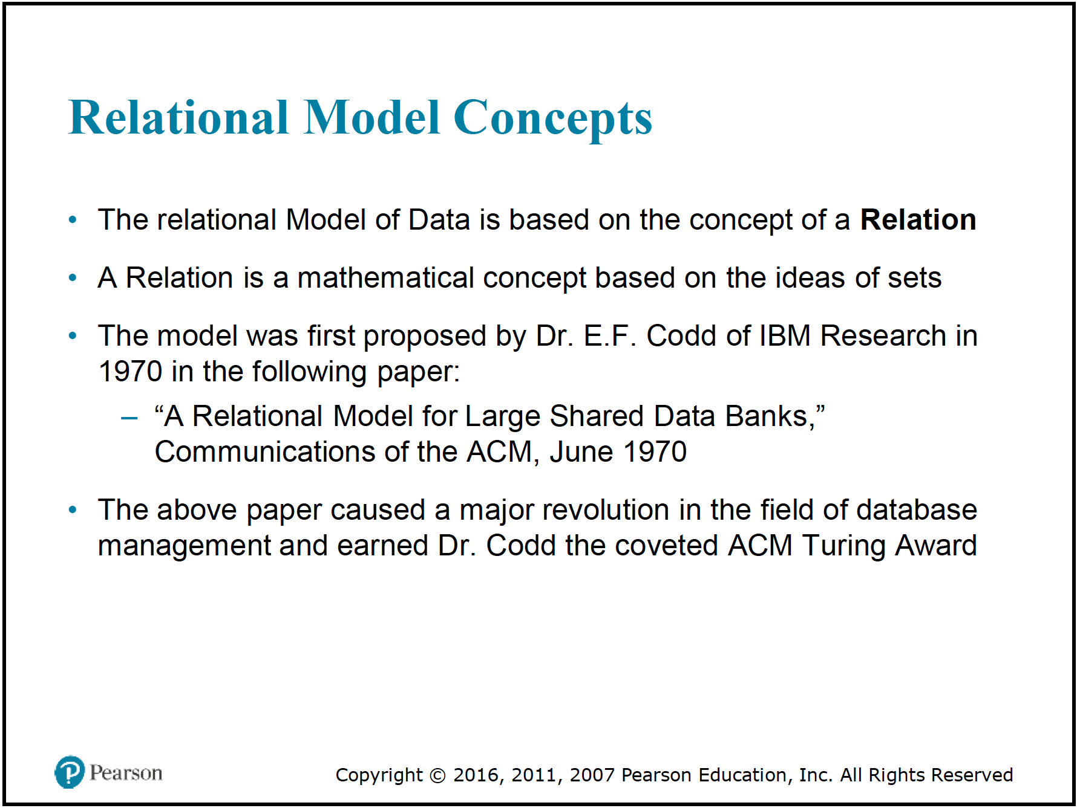
Review
1. Relational Model Concepts

Slide 3
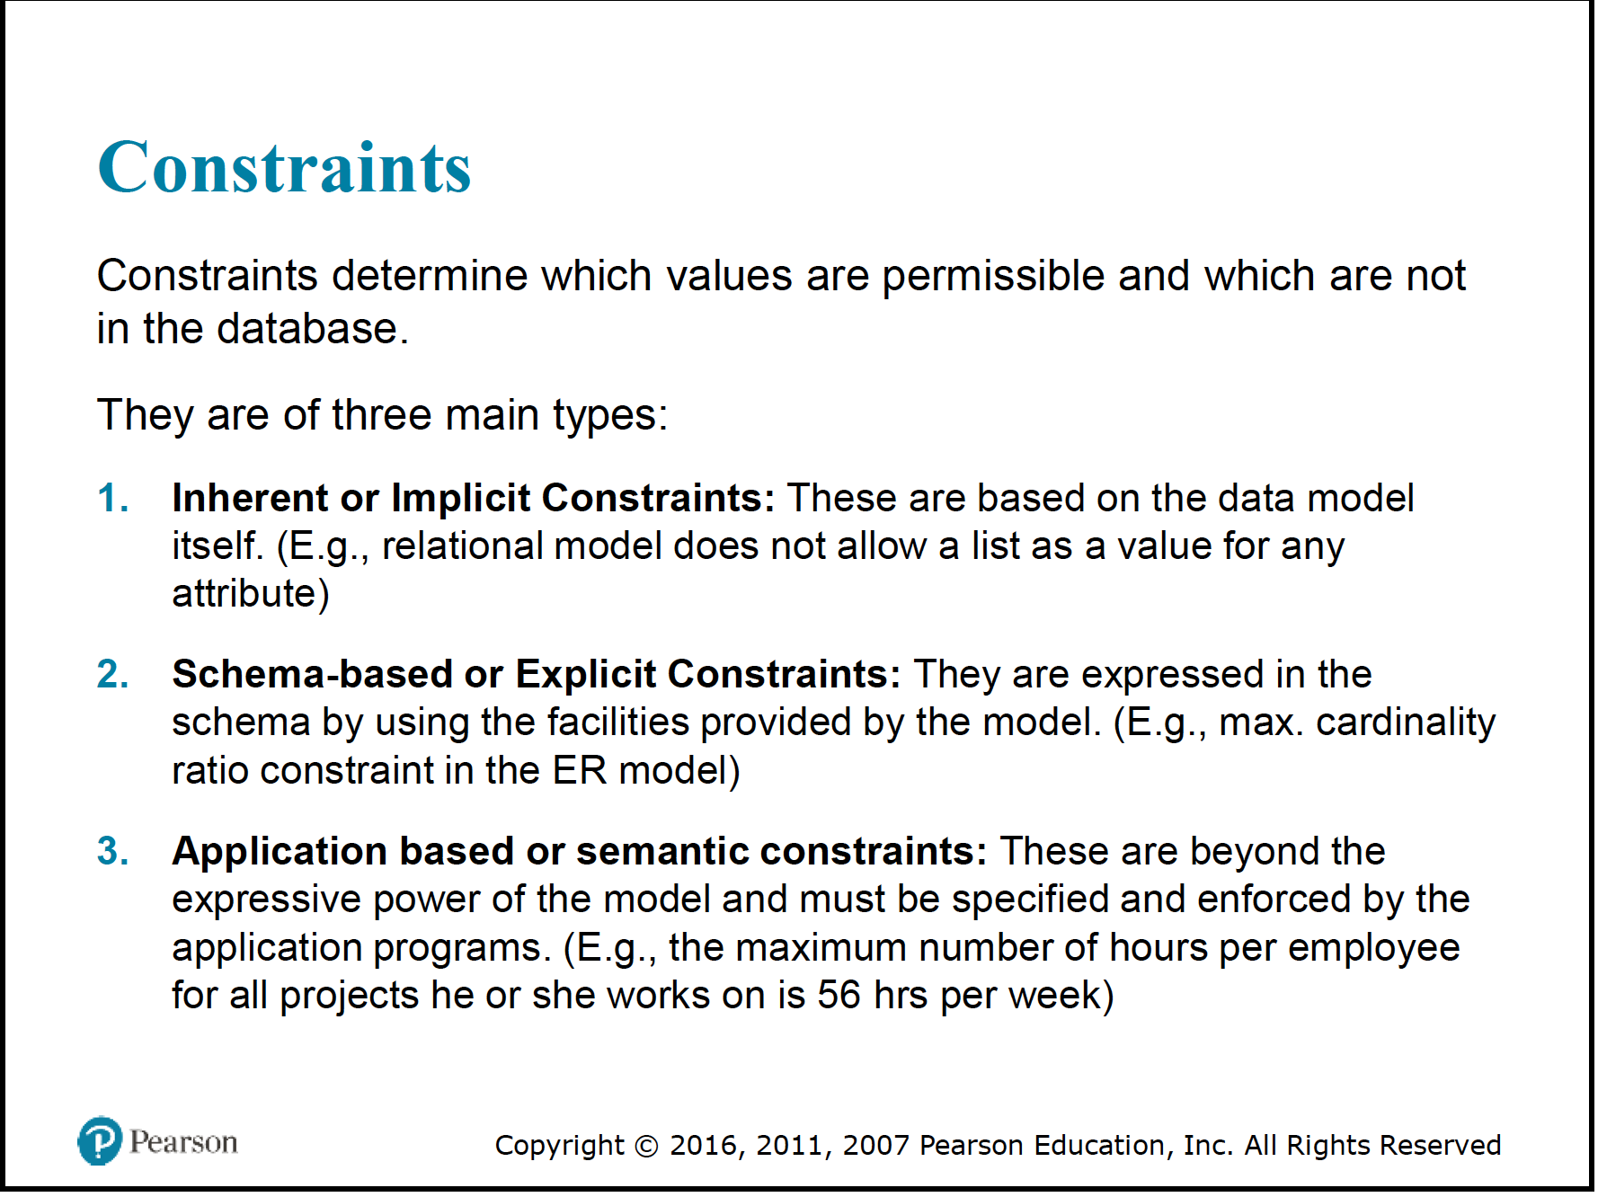
Review
2. Relational Model Constraints and Relational Database Schemas

Slide 4
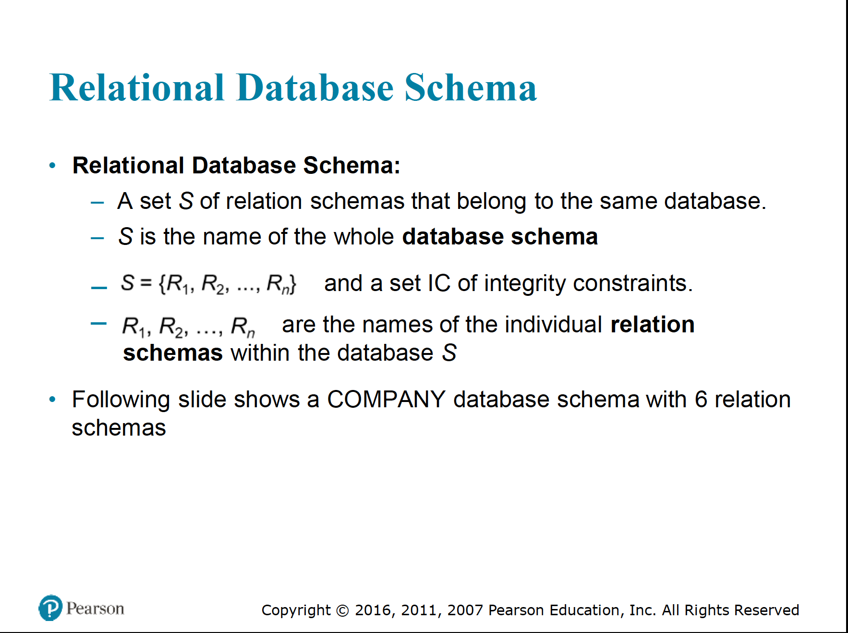
Review
2. Relational Model Constraints and Relational Database Schemas

Slide 5
Review
3. Retrieval, INSERT, DELETE, and UPDATE Statements in SQL

Slide 6
Mercury Account
1. Using SSH / PuTTY connect to the server mercury.swin.edu.au. 2. Log in with your mercury username and your SIMS password. 3. When successful, this will trigger scripts to make your web server directories ready for use and display a confirming message.
Once your mercury user work space and directories have been created, you generally will not need to use PuTTY again.

Slide 7
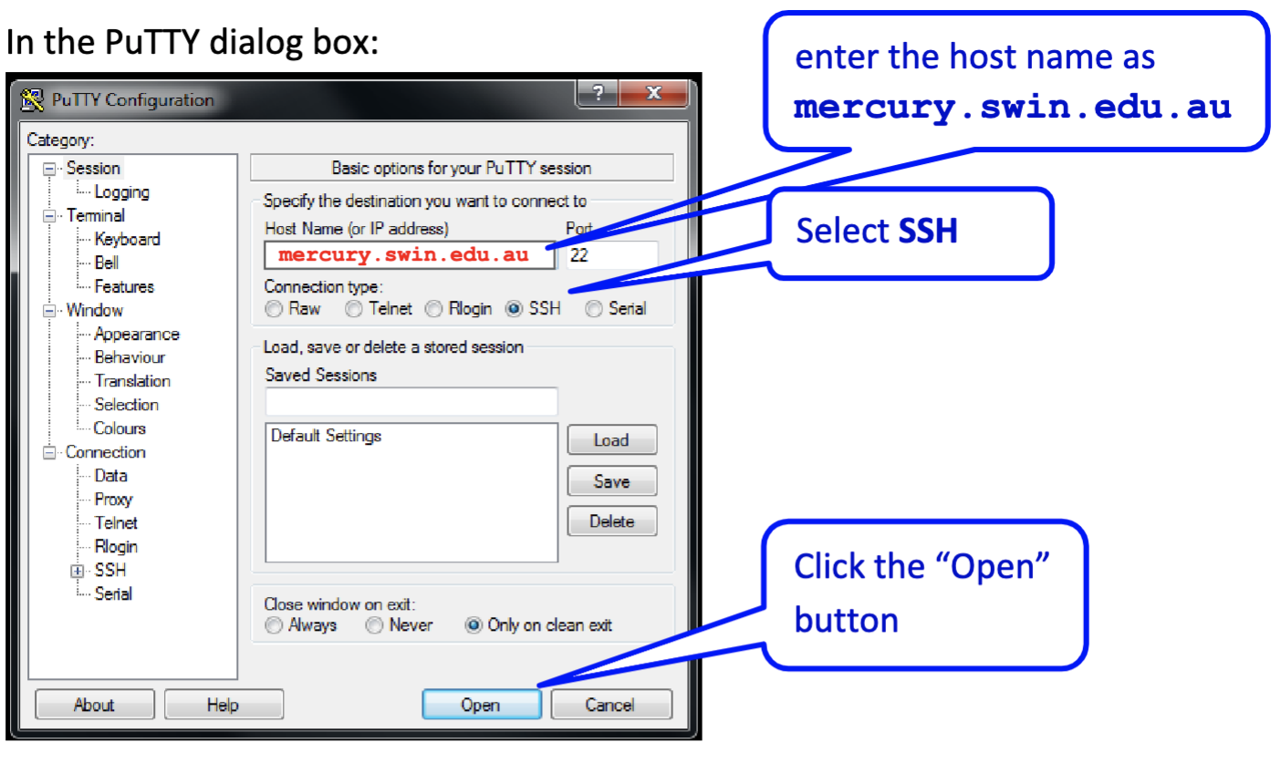
Mercury Account

Slide 8

Mercury Account
Login using with your mercury username,
this is an s followed by your 7-digit or 10-digit Student ID, eg. “s1234567”
Then enter your SIMS password
You will not see your password as you type it in!
Then press the ‘enter’ key.

Slide 9

Mercury Account
PASSWORD: DD/MM/YY (Your Birthday)

Slide 10
Database Management
CREATE DATABASE [IF NOT EXISTS] database_name
[CHARACTER SET charset_name]
[COLLATE collation_name];
CREATE DATABASE mydatabase
CHARACTER SET utf8mb4
COLLATE utf8mb4_general_ci;
CREATE DATABASE IF NOT EXISTS mydatabase;
DROP DATABASE <database_name>;
OR
DROP DATABASE [IF EXISTS] <database_name>;

Slide 11
Database Management
USE database_name;
CREATE TABLE table_name (
column1 datatype,
column2 datatype,
...
);
CREATE TABLE IF NOT EXISTS `database_tbl`( `database_id` INT UNSIGNED AUTO_INCREMENT, `database_title` VARCHAR(100) NOT NULL, `database_author` VARCHAR(40) NOT NULL, `submission_date` DATE, PRIMARY KEY ( `database_id` ) );

Slide 12
TOPIC 5
1) Create a MySQL database table named 'inventory' in MySQL Monitor, a command-line program by following
mysql> CREATE TABLE inventory (
item_number int NOT NULL AUTO_INCREMENT,
make varchar(30) NOT NULL,
model varchar(30) NOT NULL,
price double NOT NULL,
quantity int NOT NULL,
PRIMARY KEY (item_number)
);

Slide 13
Database Management
DROP TABLE table_name ;
OR
DROP TABLE [IF EXISTS] table_name;
INSERT INTO table_name (column1, column2, column3, ...)
VALUES (value1, value2, value3, ...);
INSERT INTO users (username, email, birthdate, is_active)
VALUES
('test1', 'test1@runoob.com', '1985-07-10', true),
('test2', 'test2@runoob.com', '1988-11-25', false),
('test3', 'test3@runoob.com', '1993-05-03', true);

Slide 14
Database Management
UPDATE table_name
SET column1 = value1, column2 = value2, ...
WHERE condition;
DELETE FROM table_name
WHERE condition;
UPDATE employees
SET salary = 60000
WHERE employee_id = 101;
DELETE FROM students
WHERE graduation_year = 2021;

Slide 15
Database Management
-- Select all rows in all columns
SELECT * FROM users;
-- Select all rows of a specific column
SELECT username, email FROM users;
-- Add a WHERE clause to select rows that meet the conditions
SELECT * FROM users WHERE is_active = TRUE;
--Add ORDER BY clause to sort in ascending order of a certain column
SELECT * FROM users ORDER BY birthdate;
-- Add an ORDER BY clause to sort in descending order of a column
SELECT * FROM users ORDER BY birthdate DESC;
-- Add LIMIT clause to limit the number of rows returned
SELECT * FROM users LIMIT 10;

Slide 16
TOPIC 1
Review the following terms as they apply to the relational model of data: domain, attribute, n-tuple, relation schema, relation state, relational database schema, and relational database state.

Slide 17
TOPIC 1
Domain attribute
n-tuple
Book ID | Title | Author | Genre | Price
1 | Harry Potter and the Sorcerer's Stone | J.K. Rowling | Fantasy | $15
2 | To Kill a Mockingbird | Harper Lee | Fiction | $12
3 | The Great Gatsby | F. Scott Fitzgerald | Classic Literature | $10
4 | The Da Vinci Code | Dan Brown | Mystery/Thriller | $14
5 | Becoming | Michelle Obama | Biography | $18

Slide 18
TOPIC 1
Review the following terms as they apply to the relational model of data: domain, attribute, n-tuple, relation schema, relation state, relational database schema, and relational database state.
1. Domain: In the relational model of data, a domain refers to the set of all possible values that an attribute can take. Each attribute in a relation is associated with a specific domain, which defines the data type and range of valid values for that attribute. Domains help ensure data integrity by constraining the values that can be stored in each attribute.
Books:
Name | Author | Genre | …
Example of the "Genre" attribute domain:
Fiction Mystery/Thriller Romance Science Fiction Fantasy Non-fiction Biography History Self-help Poetry …
Refer to Slides 7-9

Slide 19
TOPIC 1
Review the following terms as they apply to the relational model of data: domain, attribute, n-tuple, relation schema, relation state, relational database schema, and relational database state.
2. Attribute: An attribute represents a specific characteristic or property of an entity or object in a relation. It corresponds to a column in a relation and holds the actual data values. Each attribute is associated with a domain that specifies the type of data it can store, such as integers, strings, dates, etc.
Book ID | Title | Author | Genre | Price
1 | Harry Potter and the Sorcerer's Stone | J.K. Rowling | Fantasy | $15
2 | To Kill a Mockingbird | Harper Lee | Fiction | $12
3 | The Great Gatsby | F. Scott Fitzgerald | Classic Literature | $10
4 | The Da Vinci Code | Dan Brown | Mystery/Thriller | $14
5 | Becoming | Michelle Obama | Biography | $18
Refer to Slides 5, 7

Slide 20
TOPIC 1
Review the following terms as they apply to the relational model of data: domain, attribute, n-tuple, relation schema, relation state, relational database schema, and relational database state.
3. n-tuple: An n-tuple, also known as a row or record, represents a single data entry in a relation. It consists of a collection of values, one for each attribute in the relation. Each n-tuple is uniquely identified by its primary key, and together, all the n-tuples in a relation make up the relation state.
Employee ID | First Name | Last Name | Age | Department | Salary
101 | John | Doe | 30 | Sales | $50000
102 | Jane | Smith | 28 | HR | $55000
103 | Mark | Johnson | 35 | Marketing | $60000
the first n-tuple represents an employee with Employee ID 101, First Name John, Last Name Doe, Age 30, working in the Sales Department, and earning a salary of $50,000. Similarly, the second and third n-tuples represent different employees with their respective details.
(Refer to Slides 8, 10)
Notes:
In this example, each row (n-tuple) in the "Employees" table represents a specific employee record. The attributes (columns) in the n-tuple hold information about the employee, such as Employee ID, First Name, Last Name, Age, Department, and Salary. Each n-tuple uniquely identifies an employee within the table and represents a complete set of data for that employee.

Slide 21
TOPIC 1
relation schema and relational database schema
relation state and relational database state

Slide 22
TOPIC 1
Review the following terms as they apply to the relational model of data: domain, attribute, n-tuple, relation schema, relation state, relational database schema, and relational database state.
4. Relation Schema: The relation schema defines the structure of a relation. It specifies the name of the relation, along with the names and data types of its attributes. The relation schema remains constant and serves as a blueprint for creating instances of the relation (relation states).
Attribute | Data Type
Employee ID | Integer
First Name | Text
Last Name | Text
Age | Integer
Department | Text
Salary | Decimal
Refer to Slide 7

Slide 23
TOPIC 1
Review the following terms as they apply to the relational model of data: domain, attribute, n-tuple, relation schema, relation state, relational database schema, and relational database state.
6. Relational Database Schema: The relational database schema is a collection of relation schemas that belong to the same database. It defines the entire structure of the database, including the names of all relations, their attributes, and the relationships between them. The relational database schema is fixed and stable, providing a comprehensive overview of the database's organization.

Slide 24
Attribute | Data Type
CustomerID | Integer
FirstName | Text
LastName | Text
Email | Text
Address | Text
Phone | Text
Attribute | Data Type
ProductID | Integer
ProductName | Text
Category | Text
Price | Decimal
Stock | Integer
Attribute | Data Type
OrderID | Integer
CustomerID | Integer
OrderDate | Date
TotalAmount | Decimal
Attribute | Data Type
OrderID | Integer
ProductID | Integer
Quantity | Integer
Subtotal | Decimal
The Orders table tracks order information, including OrderID, CustomerID (which links to the Customers table), OrderDate, and TotalAmount. The OrderDetails table holds the details of individual products within each order, with attributes like OrderID (linking to Orders table), ProductID (linking to Products table), Quantity, and Subtotal.
Notes:
The relational database schema serves as a blueprint for the entire database, defining the structure of each table, the relationships between tables (via foreign keys), and the data types for each attribute. It provides a consistent and organized approach to store and manage data, allowing users to perform efficient and structured queries for various operations on the online shopping platform.

Slide 25
TOPIC 1
Review the following terms as they apply to the relational model of data: domain, attribute, n-tuple, relation schema, relation state, relational database schema, and relational database state.
5. Relation State: A relation state is a specific instance of a relation at a particular point in time. It represents the actual data stored in the relation and consists of a set of n-tuples (rows), each containing values for all the attributes defined in the relation schema. As data is inserted, updated, or deleted, the relation state may change.

Slide 26
TOPIC 1
Review the following terms as they apply to the relational model of data: domain, attribute, n-tuple, relation schema, relation state, relational database schema, and relational database state.
7. Relational Database State: The relational database state represents the current snapshot of the entire database at a specific point in time. It includes the current state of all relations in the database, with each relation state containing the data of its respective relation. As data is inserted, modified, or deleted in any relation, the relational database state is updated accordingly.
Employee ID | First Name | Last Name | Age | Department | Salary
101 | John | Doe | 30 | Sales | $50,000
102 | Jane | Smith | 28 | HR | $55,000
103 | Mark | Johnson | 35 | Marketing | $60,000
104 | Sarah | Adams | 32 | Finance | $58,000
105 | Michael | Lee | 40 | IT | $65,000
106 | Emily | Johnson | 27 | Marketing | $52,000
Employee ID | First Name | Last Name | Age | Department | Salary
101 | John | Doe | 30 | Sales | $50,000
102 | Jane | Smith | 28 | HR | $55,000
103 | Mark | Johnson | 35 | Marketing | $60,000
104 | Sarah | Adams | 32 | Finance | $58,000
105 | Michael | Lee | 40 | IT | $65,000

Slide 27
TOPIC 2
Answer the following questions.
1) Why are tuples in a relation not ordered? Why are duplicate tuples not allowed in a relation?
2) What is the difference between a key and a superkey? Why do we designate one of the candidate keys of a relation to be the primary key?
3) Define foreign key. What is this concept used for?

Slide 28
TOPIC 2
1) Why are tuples in a relation not ordered? Why are duplicate tuples not allowed in a relation?
Tuples in a relation are not ordered because the relational model is based on the concept of sets, and sets do not have a specific order for their elements. In mathematics, a set is an unordered collection of distinct elements, and the relational model adopts this mathematical foundation. Therefore, the tuples in a relation are also considered as elements of a set, and their order is not significant.
The absence of order in tuples provides flexibility and simplicity in querying and manipulating data. When working with a relation, users can focus on the attributes (columns) of the tuples rather than their specific order, making it easier to write queries and perform various operations on the data.

Slide 29
TOPIC 2
1) Why are tuples in a relation not ordered? Why are duplicate tuples not allowed in a relation?
As for duplicate tuples, they are not allowed in a relation because a relation, as defined in the relational model, represents a mathematical relation. In mathematics, a relation is a set of ordered pairs, where each pair consists of an element from one set (domain) and an element from another set (codomain).
By disallowing duplicate tuples, the relational model ensures that each tuple in a relation represents a unique combination of attribute values, and there is no ambiguity in the data. This uniqueness property helps maintain data integrity and consistency. If duplicate tuples were allowed, it could lead to inconsistencies and difficulties in querying and updating the data.
Notes:
In summary, the relational model's choice of not ordering tuples and disallowing duplicates simplifies data manipulation, ensures data integrity, and adheres to the mathematical foundation of sets and relations.

Slide 30
Example: Employee Relation
Consider a simple Employee relation with the following attributes: EmployeeID, FirstName, LastName, and Department. Each tuple in the relation represents a unique employee record.
EmployeeID | FirstName | LastName | Department
101 | John | Doe | HR
102 | Jane | Smith | Sales
103 | Mark | Johnson | Marketing
Notes:
In this example, the Employee relation consists of three tuples, each representing an employee record. The order of the tuples is not significant; for instance, there is no inherent meaning in the fact that John Doe's record comes before Jane Smith's record.

Slide 31
Example: Employee Relation
Tuples in a Relation are Not Ordered:
If we swap the positions of the first and second tuples, the relation would remain the same:
EmployeeID | FirstName | LastName | Department
102 | Jane | Smith | Sales
101 | John | Doe | HR
103 | Mark | Johnson | Marketing
Notes:
Despite the change in order, the relation still contains the same employee records, and the information remains the same. This illustrates that the order of tuples does not affect the underlying data represented by the relation.

Slide 32
Example: Employee Relation
Duplicate Tuples Not Allowed:
In a relation, each tuple must be unique, representing a distinct combination of attribute values. Duplicate tuples are not allowed to ensure data integrity. Let's see what happens when we attempt to add a duplicate tuple:
Suppose we mistakenly try to insert a duplicate tuple for EmployeeID 101:
EmployeeID | FirstName | LastName | Department
101 | John | Doe | HR
102 | Jane | Smith | Sales
101 | John | Doe | HR
Notes:
Having a duplicate tuple violates the uniqueness constraint, and this is not allowed in a relation. The relational model enforces this constraint to avoid confusion and maintain the integrity of the data.
In conclusion, the example demonstrates that tuples in a relation are not ordered, and duplicate tuples are not allowed to preserve the mathematical foundations of sets and relations, ensure data consistency, and facilitate efficient querying and manipulation of data.

Slide 33
Key
Superkey
candidate keys
primary key
foreign key

Slide 34
Key:
A basic concept that signifies any combination of attributes used to uniquely identify tuples (records) in a relation (table).
Superkey:
An extension of the 'key' concept. Every key is a superkey, but a superkey can have additional attributes that aren't strictly necessary for unique identification.
For instance, if "StudentID" is a key, then "StudentID + StudentName" can be a superkey.

Slide 35
Candidate Key:
A special kind of superkey. It's "minimal", meaning it's the smallest possible superkey that can still uniquely identify records.
If a relation has multiple such keys, they are all considered candidate keys.
For example, if both "StudentID" and "EmailAddress" can uniquely identify students, then both are candidate keys.
Primary Key:
Out of one or more candidate keys in a relation, one is chosen as the primary key.
Its main purpose is to uniquely identify records in a table. It's a point of reference for other tables and is used to maintain data integrity.
Foreign Key:
This is a key in one relation (table) that refers to the primary key in another relation.
It's used to establish relationships between tables and ensure referential integrity.
A foreign key ensures that records in one table correspond to records in another.

Slide 36
Every key is a superkey, but a superkey can have additional attributes that aren't strictly necessary for unique identification.
All primary keys are candidate keys, but not all candidate keys become primary keys.
All candidate keys and primary keys are superkeys but not all superkeys are candidate or primary keys because superkeys can have extra attributes.
Foreign keys in one table often (but not necessarily) match the primary key in another table, linking the two tables.

Slide 37
TOPIC 2
2) What is the difference between a key and a superkey? Why do we designate one of the candidate keys of a relation to be the primary key?
Key: A set of one or more attributes that can be used to uniquely identify a tuple (or row) in a relation (or table) is called a key. It ensures that no two distinct rows have the same values in those key attributes simultaneously.
Superkey: A superkey is a set of one or more attributes that can be used to identify a tuple uniquely in a relation. So, every key is a superkey, but not every superkey is a key. The difference is that a superkey might contain additional attributes that are not strictly necessary to ensure uniqueness.
Notes:
In the context of relational databases, a key is an attribute or set of attributes that uniquely identifies each tuple (row) in a relation (table). It ensures that no two tuples in the relation have the same combination of values for the key attributes. Keys play a crucial role in maintaining data integrity and facilitating data retrieval in the database. There are different types of keys in a relation:

Slide 38
TOPIC 2
2) What is the difference between a key and a superkey? Why do we designate one of the candidate keys of a relation to be the primary key?
For example, consider a table with columns StudentID, Name, and DOB (Date of Birth). If StudentID is unique for every student, then it's a key. However, the combination of StudentID, Name, and DOB is also unique for every student, making it a superkey.
StudentID | Name | DOB | EmailAddress
101 | Alice | 2000-01-01 | alice@email.com
102 | Bob | 1999-05-05 | bob@email.com
103 | Charlie | 2001-08-08 | charlie@email.com
Notes:
Key:
A set of one or more attributes that uniquely identifies a tuple in a relation is a key.
From our table:
StudentID is a key because it uniquely identifies each student.
EmailAddress is also a key for the same reason.
Superkey:
A superkey is any combination of attributes that can be used to uniquely identify a tuple. It can have additional attributes beyond what's strictly necessary for uniqueness.
From our table:
The combination of StudentID and Name is a superkey because together they also uniquely identify students. But in this case, Name is not necessary for uniqueness as StudentID alone suffices.
The combination of StudentID, Name, and DOB is another superkey.
The combination of StudentID, Name, DOB, and EmailAddress is yet another superkey.
Actually, both StudentID and EmailAddress alone are also superkeys (in addition to being keys) since any key is also a superkey.

Slide 39
TOPIC 2
2) What is the difference between a key and a superkey? Why do we designate one of the candidate keys of a relation to be the primary key?
Designating one of the candidate keys as a primary key in a database is important for:
Uniqueness: Ensures every record is distinct.
Efficiency: Makes data operations like search or retrieval faster.
Relationships: Allows other tables to link to it, building connections between tables.
Consistency: Provides a standard way to identify records.
Stability: Once set, primary keys ideally shouldn't change.
Data Integrity: Helps in preventing errors and ensuring data stays correct.

Slide 40
Uniqueness: A primary key enforces the uniqueness of records in the relation. This ensures that no two rows in the table have the same value in the primary key fields, providing a unique identifier for each record.
Referential Integrity: The primary key acts as a point of reference for foreign keys in other relations. This is fundamental in establishing relationships between tables in a relational database. If a foreign key is set in another table, it ensures that a relationship exists to a valid record in the primary key's table.
Efficiency: Database Management Systems (DBMS) often optimize storage and retrieval operations based on primary keys. By defining a primary key, search, retrieval, update, and delete operations can become more efficient.
Simplicity: It's easier to manage relations when there's a standard, universally accepted unique identifier for each record. When there's a need to reference a specific record, the primary key value provides a consistent means of identification.
Consistency: In scenarios where a relation might have multiple candidate keys, designating one as the primary key provides clarity and consistency for developers, database administrators, and other users of the database. They can always rely on the primary key as the main point of unique identification for a record.
Immutable Nature: Ideally, the primary key value for a record should never change during the lifetime of that record. This immutability ensures stable relationships with other tables that might reference it through foreign keys.
Data Integrity: The DBMS enforces constraints on primary keys. By setting one up, you automatically get data validation ensuring that no two records have the same primary key value and that no primary key field contains a null value.

Slide 41
TOPIC 2
3) Define foreign key. What is this concept used for？
Foreign Key: A foreign key is an attribute or a set of attributes in one relation (table) that refers to the primary key of another relation. It establishes a link or relationship between the two tables.
EnrollmentID | StudentID | CourseID
A | 1 | 101
B | 1 | 102
C | 2 | 103
D | 3 | 101
StudentID | Name
1 | Alice
2 | Bob
3 | Carol
CourseID | CourseName | Instructor
101 | Math | Mr. Smith
102 | History | Mrs. Jones
103 | Science | Dr. Brown
Notes:
In the Enrollments table:
EnrollmentID is the primary key.
StudentID is a foreign key referencing StudentID in the Students table.
CourseID is a foreign key referencing CourseID in the Courses table.
How it works:
The foreign keys (StudentID and CourseID) in the Enrollments table ensure that for every enrollment, there exists a valid student in the Students table and a valid course in the Courses table.
For instance, in the Enrollments table, the first record indicates that Alice (with StudentID 1) has enrolled in the Math course (CourseID 101).
With foreign keys in place, the database will prevent adding records to the Enrollments table if they reference non-existent students or courses. This maintains referential integrity.

Slide 42
TOPIC 2
3) Define foreign key. What is this concept used for？
Foreign Key: A foreign key is an attribute or a set of attributes in one relation (table) that refers to the primary key of another relation. It establishes a link or relationship between the two tables.
EnrollmentID | StudentID | CourseID
A | 1 | 101
B | 1 | 102
C | 2 | 103
D | 3 | 101
StudentID | Name
1 | Alice
2 | Bob
3 | Carol
CourseID | CourseName | Instructor
101 | Math | Mr. Smith
102 | History | Mrs. Jones
103 | Science | Dr. Brown
Notes:
In the Enrollments table:
EnrollmentID is the primary key.
StudentID is a foreign key referencing StudentID in the Students table.
CourseID is a foreign key referencing CourseID in the Courses table.
How it works:
The foreign keys (StudentID and CourseID) in the Enrollments table ensure that for every enrollment, there exists a valid student in the Students table and a valid course in the Courses table.
For instance, in the Enrollments table, the first record indicates that Alice (with StudentID 1) has enrolled in the Math course (CourseID 101).
With foreign keys in place, the database will prevent adding records to the Enrollments table if they reference non-existent students or courses. This maintains referential integrity.

Slide 43
TOPIC 3
Suppose each of the following Update operations is applied directly to the database of Figure 5.6. Discuss all integrity constraints violated by each operation, if any, and the different ways of enforcing these constraints:
a. Insert < 'Robert', 'F', 'Scott', '943775543', '1942-06-21', '2365 Newcastle Rd, Bellaire, TX', M, 58000, '888665555', 1 > into EMPLOYEE.
b. Insert < 'ProductA', 4, 'Bellaire', 2 > into PROJECT.
c. Delete the EMPLOYEE tuple with SSN= '987654321'.
d. Modify the MGRSSN and MGRSTARTDATE of the DEPARTMENT tuple with DNUMBER=5 to '123456789' and '1988-10-01', respectively.
Notes:
(a) No constraint violations.
(b) Violates referential integrity because DNUM=2 and there is no tuple in the DEPARTMENT relation with DNUMBER=2. We may enforce the constraint by: (i) rejecting the insertion of the new PROJECT tuple, (ii) changing the value of DNUM in the new PROJECT tuple to an existing DNUMBER value in the DEPARTMENT relation, or (iii) inserting a new DEPARTMENT tuple with DNUMBER=2.
(c) Violates referential integrity because several tuples exist in the WORKS_ON, DEPENDENT, DEPARTMENT, and EMPLOYEE relations that reference the tuple being deleted from EMPLOYEE. We may enforce the constraint by: (i) rejecting the deletion, or (ii) deleting all tuples in the WORKS_ON, DEPENDENT, DEPARTMENT, and EMPLOYEE relations whose values for ESSN, ESSN, MGRSSN, and SUPERSSN, respectively, is equal to'987654321'.
(d) No constraint violations.

Slide 44
TOPIC 4
Consider the following 6 relations for an order-processing database application in a company:
CUSTOMER (Cust#, Cname, City)
ORDER (Order#, Odate, Cust#, Ord_Amt)
ORDER_ITEM (Order#, Item#, Qty)
ITEM (Item#, Unit_price)
SHIPMENT (Order#, Warehouse#, Ship_date)
WAREHOUSE (Warehouse#, City)
Here, Ord_Amt refers to total dollar amount of an order; Odate is the date the order was placed; Ship_date is the date an order (or part of an order) is shipped from the warehouse. Assume that an order can be shipped from several warehouses.
Specify the foreign keys for this schema.
Notes:
Strictly speaking, a foreign key is a set of attributes, but when that set contains only one attribute, then that attribute itself is often informally called a foreign key. The schema of this question has the following five foreign keys:
1. the attribute Cust# of relation ORDER that references relation CUSTOMER,
2. the attribute Order# of relation ORDER_ITEM that references relation ORDER,
3. the attribute Item# of relation ORDER_ITEM that references relation ITEM,
4. the attribute Order# of relation SHIPMENT that references relation ORDER, and
5. the attribute Warehouse# of relation SHIPMENT that references relation WAREHOUSE.

Slide 45
TOPIC 5
1) Create a MySQL database table named 'inventory' in MySQL Monitor, a command-line program by following
mysql> CREATE TABLE inventory (
item_number int NOT NULL AUTO_INCREMENT,
make varchar(30) NOT NULL,
model varchar(30) NOT NULL,
price double NOT NULL,
quantity int NOT NULL,
PRIMARY KEY (item_number)
);

Slide 46
Topic 5
2) Insert at least 3 records into the table.
3) Write a query that return all records of the table.
4) Update an existing table row using 'update' statement.

Slide 47
Topic 6
f) Specify the following queries in SQL and show the result of each query on the COMPANY database in Figure 5.6. a. Retrieve the names of all employees in department 5 who earns more than 30000. b. Retrieve the names of all employees in department 5 who earns more than 30000 and works on ProductZ project.
Notes:
SELECT Fname, Minit, Lname FROM employee WHERE salary > 30000 and dno = 5;
SELECT Fname, Minit, Lname FROM employee e, works_on w, project p WHERE salary > 30000 and dno = 5 and e.ssn = w.essn and w.pno = p.pnumber and p.pname = ‘ProjectZ’;

Slide 48
Topic 7
Specify some updates (b, c, d) in Question c) using the SQL update commands.
Notes:
(b) Insert < 'ProductA', 4, 'Bellaire', 2 > into PROJECT. INSERT INTO PROJECT VALUES ('ProductA', 4, 'Bellaire', 2);
(c) Delete the EMPLOYEE tuple with SSN= '987654321'. DELETE FROM EMPLOYEE WHERE SSN= '987654321’;
(d) Modify the MGRSSN and MGRSTARTDATE of the DEPARTMENT tuple with DNUMBER=5 to '123456789' and '1988-10-01', respectively. UPDATE DEPARTMENT SET MGRSSN = '123456789', MGRSTARTDATE = '1988-10-01' WHERE DNUMBER= 5;

Slide 49


